Slide 1
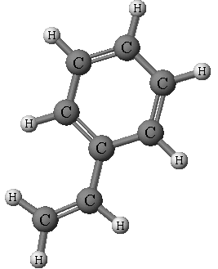
Classifying Organic Compounds

Slide 2
Overview
Organic compounds under study:
Hydrocarbons (aliphatic and aromatic)
Alcohols
Ethers
Amines
Aldehydes
Ketones
Carboxylic acids
Esters
Amides

Slide 3
Overview
For each class of organic compound, you will:
Name and write chemical formulas
Draw structural diagrams
Describe similarities and differences in physical properties based on intermolecular forces
Identify common names and examples

Slide 4
Hydrocarbons
Composed entirely of carbon and hydrogen
atoms
Aliphatic hydrocarbons’ carbon atoms are bonded in chains or rings
Aromatic hydrocarbons’ structure is based on the benzene group

Slide 5
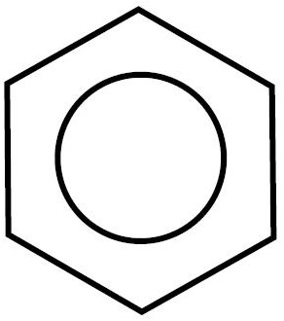
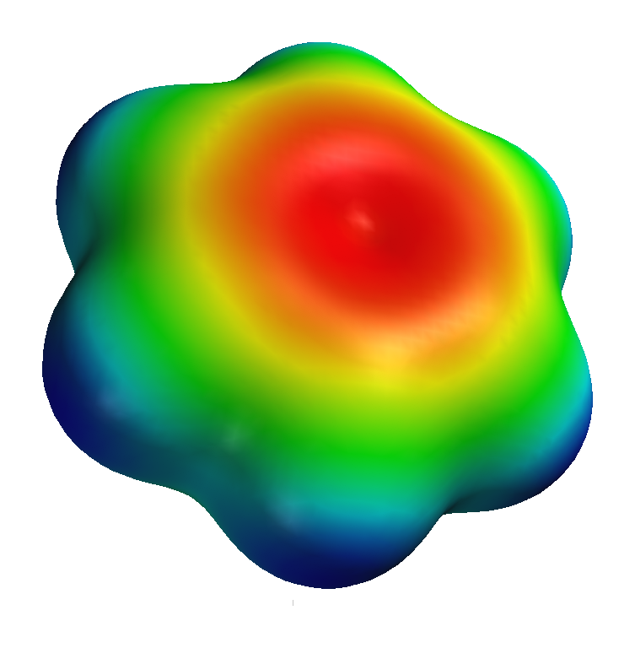
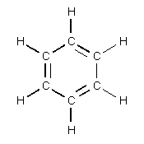
Benzene
Benzene is a cyclic compound with the
equivalent of three double bonds and three
single bonds shared among six carbon atoms
Benzene is the basis for aromatic hydrocarbons

Slide 6
Functional Groups
A functional group is a common group of
bonded atoms that reacts in a characteristic
way, thus determining a chemical families’
physical and chemical properties
Alkane –only single bonds
Alkene –one or more double bonds
Alkyne –one or more triple bonds

Slide 7
IUPAC
The International Union of Pure and Applied
Chemistry’s rules for naming organic
compounds follows the pattern:
prefix + root + suffix

Slide 8
Root
The root indicates the number of carbon atoms in the main chain or ring
The main chain is the longest possible chain and must include multiple bonds
If there is a ring, it is usually the main chain
meth
eth
prop
but
pent
hex
hept
oct
non
dec

Slide 9
Suffix
The suffix indicates the class of compound,
according to its functional groups
ie. -ane, -ene, -yne, -ol, -amine, -al, -one, -oic -acid, -oate, -amide, etc.

Slide 10
Prefix
The prefix indicates the name and location of
each branch and functional group on the main
chain
An alkyl group is a hydrocarbon branch with the suffix –yl

Slide 11
Naming Hydrocarbons
Steps
Find the root (longest chain)
Assign position numbers on the main chain
Find the suffix (-ane, -ene, or -yne)
Find the prefix (branches)
Combine: prefix + root + suffix
See p. 14 for further information and examples

Slide 12
Structural Diagrams
A structural diagram is a simple drawing of a
molecule
Complete structural diagrams include all atoms and represent bonds with straight lines
Condensed structural diagrams omit hydrogen bonds
Line structural diagrams omit carbon atoms and use a zig-zag pattern for single and double bonds
In this course, we mainly use condensed structural
diagrams

Slide 13
Drawing Hydrocarbons
Steps
Draw and number the carbon atoms of the main chain
Draw the bonds between carbon atoms
Add the branches
Add hydrogen atoms

Slide 14
Cis-trans isomers
Isomers are molecules that have the same
molecular formula, but have a different molecular
arrangement
Cis-trans isomers occur when there is a restricted
rotation in a molecule (ie. double bond)
Trans isomers have unique branches on opposite sides of a double bond
Cis isomers have unique branches on the same side of a double bond

Slide 15
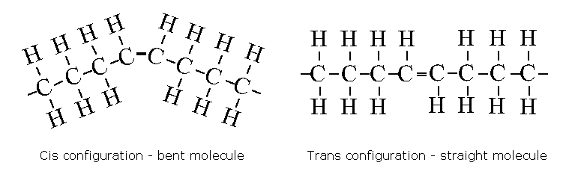
Cis-trans isomers
Trans fats contain at least one double bond with hydrogen atoms in the trans configuration

Slide 16
Hydrocarbon Properties
Polarity and Solubility
Hydrocarbons are non-polar and insoluble in water
Boiling Points
Low boiling points, increasing with size
Other Properties
Triple bonds are more reactive than double bonds
Double bonds are more reactive than single bonds

Slide 17
Explaining Properties
Physical properties are largely determined by
intermolecular forces, such as:
Dipole-dipole interactions
Force of attraction between polar molecules
Orient themselves so that oppositely charged ends of the molecules are near to one another

Slide 18
Explaining Properties
Physical properties are largely determined by
intermolecular forces, such as:
Hydrogen bonding
Exists between a hydrogen atom in a polar bonded molecule such as H-O, H-N, or H-F and the lone pairs of an electronegative atom such as O, F or N

Slide 19
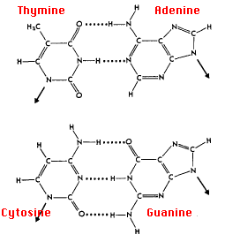
Explaining Properties
Hydrogen bonds are responsible for base pairing in the DNA molecule

Slide 20
Explaining Properties
Physical properties are largely determined by
intermolecular forces, such as:
Dispersion forces
Occur between all covalent molecules
Electron vibrations produce momentary polarity that can induce a dipole in nearby molecules
Strengthen as molecule size increases

Slide 21
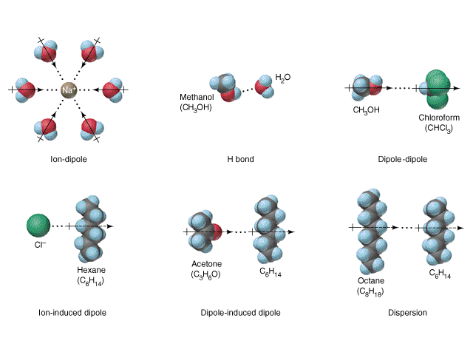
Explaining Properties

Slide 22
Predicting Properties
Draw a few molecules of the compound(s) and
ask the following questions:
Are the molecules polar?
Polar molecules have higher boiling points

Slide 23
Predicting Properties
Draw a few molecules of the compound(s) and ask
the following questions:
Can the molecules form hydrogen bonds?
Molecules that can form hydrogen bonds with themselves have higher boiling points
Molecules that can form hydrogen bonds with water are usually soluble

Slide 24
Predicting Properties
Draw a few molecules of the compound(s) and
ask the following questions:
How strong are the dispersion forces?
Dispersion forces are larger in molecules with a greater number of carbon atoms, therefore they have higher boiling points

Slide 25
Alcohol Properties
Polarity and Solubility
The O-H bond in the hydroxyl group is very polar, however, smaller alcohols are more polar than larger alcohols
Alcohols can form hydrogen bonds, therefore, they are very soluble in water
Melting and Boiling Points
Most alcohols have higher melting and boiling points than similar alkanes due to hydrogen bonding
Other Properties
Flammable and poisonous

Slide 26
Naming Alcohols
Steps
Find the root (longest chain with –OH)
Find the suffix (replace –e with –ol)
Assign position numbers on the main chain
Find the prefix (branches)
Combine: prefix + root + suffix

Slide 27
Assignment
Create a graphic organizer that describes:
Structure
Examples
Properties
Naming Rules
for the ten classes of organic compounds:
Aliphatic Hydrocarbons, Aromatic Hydrocarbons, Alcohols, Ethers, Amines, Aldehydes, Ketones, Carboxylic Acids, Esters and Amides
Suggestion:
Start with the
table on p. 22!

